Slide 1
Deep Learning
LSTMs and Constant Failure

Slide 2
CONTENTS
Model 1
Trained the same way Yunjey did it.
Model 2
The model we screwed up in.
Image is input as hidden state while training, and while sampling.
Model 3
The model where we fixed our errors. Image is now as a cell state while training.
Q & A
To screw us up even further

Slide 3
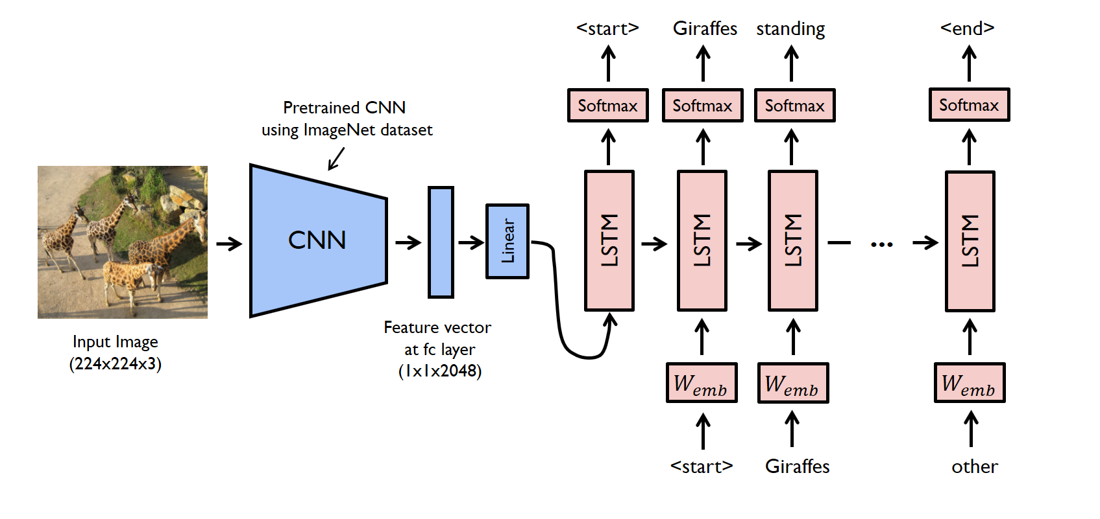
Yunjey’s Model
Sampling method, not training method actually.
Notes:
This part is where we point out yunjey is a big fat liar.
So this is the sampling method actually. Sampling for these things are pretty much standardised anyway.
How he actually trains is completely different. To illustrate this, here’s a different image.

Slide 4
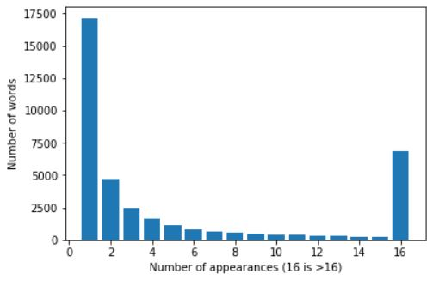
BAD GROUND
Only a total of 38406 unique words in the dataset.
A majority of words do not appear more than once (17150 words).
We opted not to edit the dataset in our training, using those words as part of the training or validation data accordingly.
Might result in a large amount of the unknown word token showing up in the training set, heavily impacting performance.

Slide 5
BAD GROUND
However, a large proportion of the unique words are misspelled words.
Still possible to fix by running spellchecker on dataset.
Examples:
Sittng, blankent, bicy, PEEING, Jew, oranfe, ruwnay
Some are hopeless however.

Slide 6
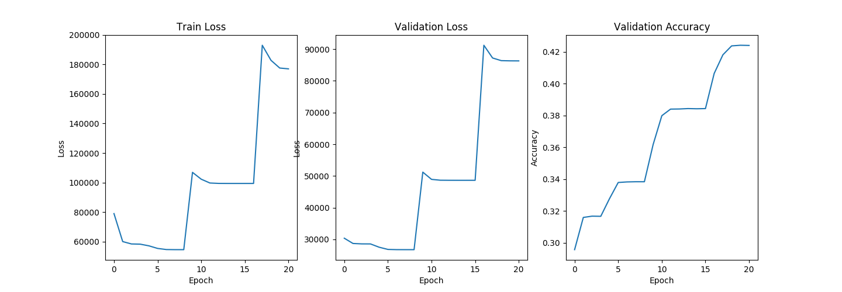
Yunjey’s model
Image and cap
Restarted Model several times due to stagnation. (early stopping was applied)
Notes:
Note that we restarted at some points.

Slide 7
Hyper Parameters
Hyper Parameters/Training method
VGG19_batch norm – frozen
Linear Layer (original’s in features, embedding size)
Embedding size: 50. Non pretrained
learning rate = 0.001
momentum = 0.9
number of layered LSTMs = 2
number of hidden dimensions in LSTM = 300
Loss function = Cross Entropy Loss (we didn’t logsoftmax)
Decay rate = 0.9 (Multiplier applied with every epoch end)
Training Transforms
Testing Transforms
transforms.Compose([
transforms.Resize(300),
transforms.RandomCrop(224),
transforms.RandomHorizontalFlip(),
transforms.ToTensor(),
transforms.Normalize( (0.485, 0.456, 0.406),
(0.229, 0.224, 0.225))])
transforms.Compose([
transforms.Resize(224),
transforms.CenterCrop(224),
transforms.ToTensor(),
transforms.Normalize( (0.485, 0.456, 0.406),
(0.229, 0.224, 0.225))])

Slide 8
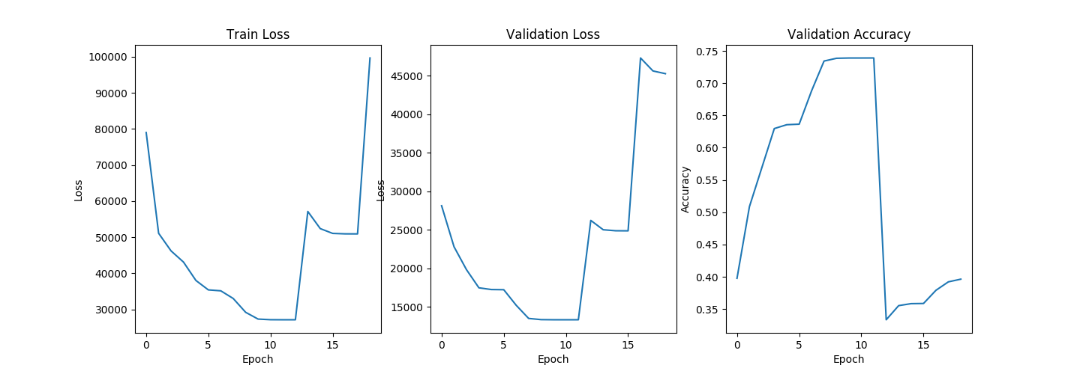
Model 2
Input image as initial hidden state

Slide 9
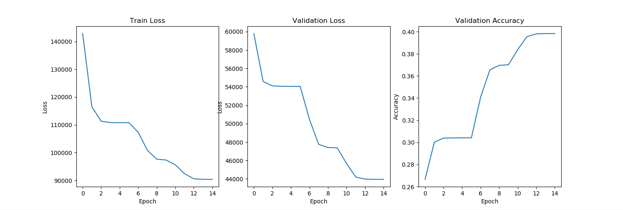
Model 3
Input image as initial cell state

Slide 10
Evaluation
Image as Hidden State
BLEU SCORE
Using top k to predict the word:
1: 0.08152598353205782
2: 4.171115022461521e-155
3: 3.8125002348036435e-204
4: 9.558226113561296e-232
Using sampling to predict the word:
1: 0.06552827314881415
2: 4.888507480249821e-06
3: 3.749523101562328e-107
4: 2.925910477864098e-159

Slide 11
Evaluation
Image as Cell State
BLEU SCORE
Using top k to predict the word:
1: 0.08251634148204581
2: 4.205684304364918e-155
3: 3.83884023597533e-204
4: 9.617969610692441e-232
Using sampling to predict the word:
1: 0.0712434329779113
2: 5.188493402467781e-06
3: 4.051501842982537e-107
4: 3.1904772186924304e-159

Slide 12
Q&A
Jun Qing Chang, Tai Hong Wen, Shaun Toh

